Slide 1
POS System
Made By: Ayham Alkhalaileh

Slide 2
Introduction
A point-of-sale (POS) system is the hardware and software that enables you to make sales, accept payments, and check out customers. Whether you want to open a retail store, pop up shop, sell at events, or out of the trunk of your car, you need a POS system to accept payments and sell in person.

Slide 3
Problem Statement
HTU store needs a program that stores transactions and inventory in an electronic way instead of the traditional method that takes a long time and consumes more effort.

Slide 4
Objectives
Login
Informative dashboard
Selling dashboard
Stock management page
Transactions dashboard
Users’ dashboard
Profile Page

Slide 5
System Analysis
1- Administrator: controls all parts of the system.
2- Seller: controls the selling panel only.
3- Procurement : only controls the inventory management page.
4-Accountant: Controls the transaction management page only.
5-Security (login, password hashing, SQL injection and XSS)
6- Availability
7- The ability to control

Slide 6
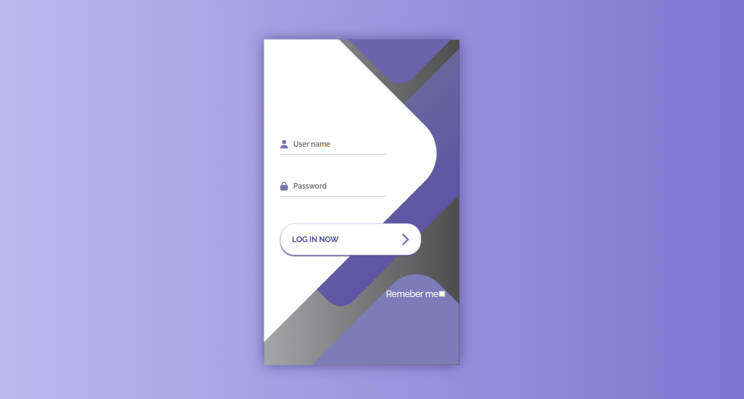
Implementation

Slide 7
Conclusion
Finally, the POS system will improve store efficiency, accuracy, and overall customer experience, leading to increased profits. The project is to create a web application that meets these requirements. The point of sale system will enable him to manage his shop with high efficiency and save time and effort if the project goals are achieved.

